Slide 1
AIDI 1010 – Introduction to Emerging Technologies WEEK7
Jahanzeb Abbas (JB)

Slide 2
Week Objectives
Use AutoML for classification, regression, and forecasting
(A) MLJAR
What is it?
(B) MLJAR
Pros/Cons
Hyperparameters
(C) Examples
(D) References

Slide 3

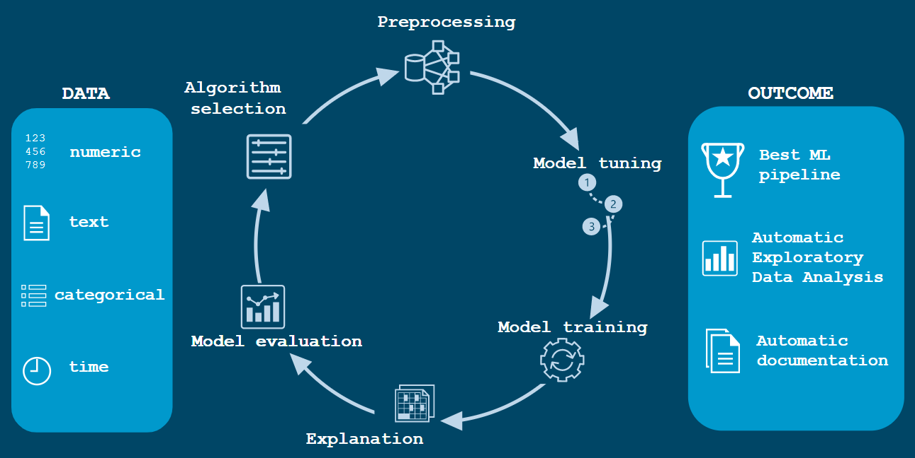
(A) MLJAR (What is it?)
MLJAR = Machine Learning JAR (Machine Learning For Humans); an open-source Python library enabling AutoML
MLJAR was created by Aleksandra Plonska and Piotr Plonski, et al. in 2016;
MLJAR is a tool that allows automation of the search for optimal hyperparameters for any ML model being used
MLJAR can be used for binary/multi-class classification and regression tasks
MLJAR can assist a data scientist in generating a ML pipeline
https://raw.githubusercontent.com/mljar/mljar-examples/master/media/AutoML_overview_mljar_v3.svg

Slide 4
(A) MLJAR (What is it?)
MLJAR features:
Works flawlessly with tabular data, and abstracts the common way to preprocess the data
Check the details of every step of the AutoML training
ML Task is detected automatically based on target values; however, one can also manually enforce the ML Task by using the ml_task parameter
Constructs ML models and perform hyperparameters tuning to find the best model
Produces detailed markdown reports unique to the kind of mode (using XGBoost, Decision Tree, Logicstic Regression) for each ML model, it details out a table information about each model score and time needed to train the model. There’s a link for each model used showing performance of all models for easy comparison and to visually inspect the best out of the models!
Help explain data with detailed evaluation metrics within reports.
Ability to compute “Baseline” for your data, meaning you will know if you need ML or not for your data while using many other algorithms
Feature preprocessing: missing values imputation, converting categoricals, handle target values preprocessing (like converting target to numeric)
Tune hyperparameters with not-so-random-search algorithm (random-search over defined set of values) and hill climbing to fine-tune final models; hill-climbing: all checked models are saved and used for building Ensemble.
MLJAR builds several models depending on the algorithms selected and obtaining the final predictions via ensembling or stacking the models

Slide 5
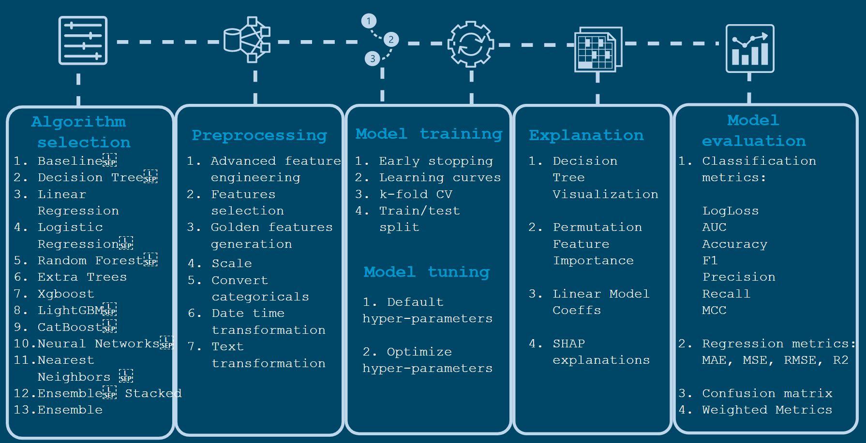
(A) MLJAR (What is it?)
https://raw.githubusercontent.com/mljar/mljar-examples/master/media/AutoML_overview_mljar_v3.svg

Slide 6

TANGENT: MLJAR – Details (1)
MLJAR has four modes: Explain, Perform, Compute, Optuna
MLJAR Mode | MLJAR Mode Explanation
EXPLAIN | To be used when user wants to explain and understand data. Fastest mode available with default hyperparameters. By default uses 75/25 train/test split. It is using: Baseline, Linear, Decision Tree, Random Forest, Xgboost, Neural Network algorithms and ensemble. It has full explanations: learning curves, importance plots, and SHAP plots
PERFORM | To be used when the user wants to train a model that will be used in real-life use cases. Slowest mode available, uses advanced feature engineering, ensembling, and stacking. Highly-tuned pipeline is produced. It is using 5-fold CrossValidation (CV). It is using: Linear, Random Forest, LightGBM, Xgboost, CatBoost and Neural Network. It uses ensembling. It has learning curves and importance plots in reports.
COMPUTE | To be used for machine learning competitions. Balanced mode, balance between speed of training and accuracy. Best mode for training production-ready ML models. It adapts the validation strategy depending on dataset size and total_time_limit. It can be: train/test split (80/20), 5-fold CV or 10-fold CV. It is using: Linear, Decision Tree, Random Forest, Extra Trees, LightGBM, Xgboost, CatBoost, Neural Network and Nearest Neighbors. It uses ensemble and stacking. It has only learning curves in the reports.
OPTUNA | To be used when the performance is the most important and time is not limited. It is using 10-fold CV. It is using: Random Forest, Extra Trees, LightGBM, Xgboost, and CatBoost. Those algorithms are tuned by Optuna framework for optuna_time_budget seconds, each. Algorithms are tuned with original data, without advanced feature engineering. It is using advanced feature engineering, stacking and ensembling. It uses TPE sampler for tuning the hyperparameters. The hyperparameters found for original data are reused with those steps. It produces learning curves in the reports. Models checked during Optuna hyperparameters search are not saved, only the best model is saved (final model from tuning).

Slide 7
TANGENT: MLJAR – Details (2)
MLJAR – 10 Steps to AutoML
simple_algorithms – Quick training of data with to get quick insights (using Baseline, Decision Tree, Linear) and learn if complex Machine Learning is required
default_algorithms – Data trained using models with default hyperparameters.
not_so_random – Performs “Random Search” over defined set of hyperparameters.
E.g, if you set start_random_models=3
automl = AutoML(algorithms=["Xgboost", "CatBoost"], start_random_models=3)
Training is done: 1 model for Xgboost & 1 model for CatBoost with default hyperparameters in “default_algorithms” step
Training is done: 2 models for Xgboost & 2 model sfor CatBoost with default hyperparameters in “not_so_random” step
golden_features – Features identified to have best predictive power.
Divide the data into samples, while constructing a feature set for each sub-sample
Each feature set is then used to generate a new feature with different operators, which is then trained through Decision Trees.
This is done for each of the new features identified, where a score is computed for each new feature.
Each new feature with the lowest score is sorted and selected/inserted into training data; typically 5% of original features
insert_random_feature – A step before feature-selection, can be skipped if needed.
This step helps to look for signal in the data and identify some key red flags
If Baseline is better than actual models
If Baseline is close to ‘best model’
If data is overfitting quickly
To skip this step: feature_selection=False; this will skip the actual feature_selection step as well.
https://supervised.mljar.com/features/automl/

Slide 8
TANGENT: MLJAR – Details (3)
MLJAR – 10 Steps to AutoML (cont’d)
features_selection – Best model for each algorithm is selected. The model’s hypeparameters are re-used and is trained only using selected features. If all features are important then this step is skipped (No models trained under this step).
hill_climbing – Tuning of models is performed in this step, controlled by hill_climbing parameter. In each hill_climbing step, the top performing models are tuned further. This step can also be skipped by setting hill_climbing_steps=0.
ensemble – All models from previous steps are ensembled. This step can also be skipped by setting train_ensemble=False
stack – All models from previous steps are stacked. This step can also be skipped by setting stack_models=False
ensemble_stacked – All models from previous steps are ensembled (stacked and unstacked models). This step can also be skipped by setting train_ensemble=False
https://supervised.mljar.com/features/automl/

Slide 9
TANGENT: MLJAR – Details (4)
ML Types
MLJAR Evaluation Metrics
For binary: logloss, auc, f1, average_precision, accuracy; default is logloss
For multiclass: logloss, f1, accuracy; default is logloss
For regression: rmse, mse, mae, r2, mape, spearman, pearson; default is rmse
MLJAR ALgorithms:
Baseline, Linear, Random Forest, Extra Trees, LightGBM, Xgboost, CatBoost, Neural Networks, and Nearest Neighbors
MLJAR Online
You can signup to MLJAR AutoML and use their virtual environment to build models
There are many plans, including a free one to signup; https://mljar.com/pricing/
Machine Learning Type | Algorithms
Gradient descent-based | Linear Regression, Ridge Regression, Lasso Regression, Elasticnet Regression, Neural Network (Deep Learning)
Distance-based | K Nearest Neighbors, Support Vector Machine, K-means, Hierarchical clustering
Tree-based | Decision Tree, Random Forest, Gradient Boosting Machine, Light GBM, Extreme Gradient Boosting,

Slide 10
(B) MLJAR: Pros/Cons
PROS | CONS
Designed for all levels of datasets and to be used with multiple cores/machines; an open-source & closed-source solution | Might require heavier system requirements to run; a closed-source solution allows one to run in their virtual environment for a fee
Easy Install & Multi-mode Performance | Need to know about ML models a bit more especially for fine-tuning and feature processing
Creates markdown reports explaining every single detail about model creation
Detailed documentation & creator support

Slide 11
(B) MLJAR: Hyperparameters
MLJAR AutoML (Class)
Parameter name | Default value | Description
results_path | None | The path with results. If None, then the name of directory will be generated with the template: AutoML_{number}, where the number can be from 1 to 1,000
total_time_limit | 3600 | The total time limit in seconds for AutoML training. It is not used when model_time_limit is not None.
mode | ‘Explain’ | Can be {Explain, Perform, Compete, Optuna}. This parameter defines the goal of AutoML and how intensive the AutoML search will be.
ml_task | ‘auto’ | Can be {"auto", "binary_classification", "multiclass_classification", "regression"}. If left auto AutoML will try to guess the task based on target values. If there will be only 2 values in the target, then task will be set to "binary_classification". If number of values in the target will be between 2 and 20 (included), then task will be set to "multiclass_classification". In all other casses, the task is set to "regression".
model_time_limit | None | The time limit for training a single model, in seconds. If model_time_limit is set, the total_time_limit is not respected.
algorithms | ‘auto’ | The selected list of algorithms (in MLJAR) that will be used in the training.
train_ensemble | True | Whether an ensemble gets created at the end of the training.
stack_models | ‘auto’ | Whether a models stack gets created at the end of the training. Stack level is 1.
eval_metric | ‘auto’ | The selected evaluation metric to be used in early stopping and to compare models.
validation_strategy | ‘auto’ | Dictionary with validation type. Right now train/test split and cross-validation are supported.
explain_level | ‘auto’ | Level of explanations included for each model; 0=no details; 1=importance plot, tree plots, or save coefficients; 2=same as 1 plus SHAP; auto= explanations based on mode
golden_features | ‘auto’ | Whether to use golden features If left auto AutoML will use golden features based on the selected mode. If ‘mode’ = Explain->False; Perform->True; Complete->True
features_selection | ‘auto’ | Whether to do features_selection If left auto AutoML will do feature selection based on the selected mode. If ‘mode’ = Explain->False; Perform->True; Complete->True
start_random_models | ‘auto’ | Number of starting random models to try. If left auto AutoML will select it based on the selected mode: If ‘mode’ = Explain->1; Perform->5; Complete->10
hill_climbing_steps | ‘auto’ | Number of steps to perform during hill climbing. If left auto AutoML will select it based on the selected mode. If ‘mode’ = Explain->0; Perform->2; Complete->2
top_models_to_improve | ‘auto’ | Number of best models to improve in hill_climbing steps. If left auto AutoML will select it based on the selected mode. If ‘mode’ = Explain->0; Perform->2; Complete->3
boost_on_errors | ‘auto’ | Whether a model with boost on errors from previous best model should be trained. By default available in the Compete mode.
kmeans_features | ‘auto’ | Whether a model with k-means generated features should be trained. By default available in the Compete mode.
mix_encoding | ‘auto’ | Whether a model with mixed encoding should be trained. By default it is available in the Compete mode.
max_single_prediction_time | None | The limit for prediction time for single sample. Use it if you want to have a model with fast predictions. Time is in seconds. For the mode Perform the default is 0.5 seconds.
verbose | 1 | Controls the verbosity when fitting and predicting. Note: Still not implemented, please left 1
random_state | 1234 | Controls the randomness of the AutoML
n_jobs | -1 | Number of CPU cores to be used. By default is set to -1 which means using all processors.
https://supervised.mljar.com/api/

Slide 12

(C) MLJAR: Examples

Slide 13
Disclaimer
Due to nature of the course, various materials have been compiled from different open source resources with some moderation.
The course designer (slides creator), sincerely acknowledges their hard work and contribution, credit will be given wherever necessary

Slide 14
References
https://muckrack.com/mljar-creators & https://mljar.com/about/ & https://tracxn.com/d/companies/mljar.com
https://github.com/mljar/mljar-supervised; https://supervised.mljar.com/features/modes/
https://raw.githubusercontent.com/mljar/mljar-examples/master/media/AutoML_overview_mljar_v3.svg
https://github.com/pplonski; https://github.com/mljar/mljar-supervised#faq; https://github.com/mljar/mljar-examples;
https://medium.com/@MLJARofficial?p=9b1420e8942d
https://mljar.com/ & https://github.com/mljar/mljar-supervised#documentation & https://supervised.mljar.com/api/
https://towardsdatascience.com/compare-popular-automl-frameworks-on-10-tabular-kaggle-competitions-9b1420e8942d
https://towardsdatascience.com/binary-classification-with-automated-machine-learning-1a36e78ba50f
https://medium.com/@MLJARofficial/mljar-supervised-automl-with-explanations-and-markdown-reports-36d5104e117
https://pythonrepo.com/repo/mljar-mljar-supervised-python-machine-learning
https://www.kdnuggets.com/2021/05/next-generation-automl-frameworks.html
https://www.analyticsvidhya.com/blog/2021/06/automated-machine-learning-for-supervised-learning-part-1/
https://www.freecodecamp.org/news/classification-with-python-automl/
https://mljar.com/blog/automl-optuna/
https://libraries.io/pypi/mljar-supervised
https://stackoverflow.com/questions/66273026/automl-select-the-model-manually
https://twitter.com/MLJARofficial/status/900316718639304704
https://medium.com/@MLJARofficial/are-hyper-parameters-really-important-in-machine-learning-369cf3e2dbc

Slide 15

Thank You Very Much
Any Questions?

